Slide 1
ERP Training Kick-Off
February, 2023

Slide 2
Meeting Objectives
Align on the plan to create/update Workday training materials
Discuss roles and responsibilities
Review Business Processes for Functional Area
Define start and due dates for training materials
Address functional teams questions
Schedule working sessions
Notes:
The training team has been tasked with helping to support new BH Team members as they integrate with SH and transition to Workday. As part of the BHSH integration, we are updating our ERP ecosystem, which will include two cloud-based solutions, Workday and ServiceNow, to achieve our goals of creating an adaptable and agile, future-focused healthcare organization.

Slide 3

Training Components Overview
The learning process contains five critical milestones that must occur to provide a comprehensive training experience. The milestones do not indicate “Starts & Stops” but are a logical sequence of events with overlapping timelines.
Training Needs Analysis
Training Strategy
Training Design + Development
Key Objectives:
Conduct functional area and role-specific interviews to assess training needs for Corewell
Identify individuals who will be involved in training development process
Summarize Workday and ServiceNow training needs for Corewell Team members
Training Deployment
Key Objectives:
Identify training channels and development tools
Draft high-level curriculum and development approach
Identify target audiences
Create training plan that will include an operational timeline
Training Evaluation + Sustainment
Key Objectives:
Finalize training curriculum with functional teams
Develop standardized training templates
Capture business processes with functional leads
Develop training materials
Key Objectives:
Align training material to Corewell roles
Implement Train-the-Trainer program
Upload and deploy training materials to Corewell LMS
Deliver training to Corewell team members
Key Objectives:
Monitor and evaluate training
Address training issues
Update and refine training materials
Provide post go-live training support
December – January
February
March – May
June – July
July - Ongoing

Slide 4




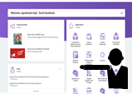
Training Overview
This overview covers the training timeline, effected learning groups, and training delivery methods.
Learner Groups
Delivery Methods
Team Members
Core HCM Team:
Core FIN Team:
Core SCM Team:
Benefits Compensation Learning Recruiting Talent
Absence
Banking & Settlement
Business Assets Customer Accounts Financial Accounting
Financial Reporting
Supplier Accounts
Endowments
Grants
Payroll Expenses
Projects Time
Inventory Procurement Reporting
Leaders
Instructor-Led Training
(ILT/vILT)
Job Aids / Knowledge Articles
Videos
Guided Demonstrations
Requesters
Configure / Prototype / Test
Deploy
Optimize
2022 | 2022 | 2023 |  |  | 2023
Aug | Sep | Oct | Nov | Dec | Jan | Feb | Mar | Apr | May | June | July | Aug
Analysis & Strategy
Training Needs Analysis
Training Strategy and Plan
Development
Training Templates
Identify SMEs
Training Content Development and Reviews
Deployment
Identify Trainers
Train-the-Trainer
Delivery
Notes:
Human Resources include Absence, Benefits, Compensation, Core HCM, Learning, Recruiting, Talent Management, Time
Finance includes Banking & Settlement, Business Assets, Customer Accounts, Expenses, Financial Accounting, Financial Reporting, Endowments, Grants, Payroll, Projects, Supplier Accounts
Supply Chain Management includes Inventory, Procurement, Reporting

Slide 5


Training Material Development Roles Details
Defined below are the roles and responsibilities involved in Workday training material development (Knowledge Articles, Instructor-Led Training (ILT/vILT), Videos, Guided Demonstrations) and approval.
Corewell SME’s and the Workday ERP Training Team will work together to update, create, and make available training content designed to increase Team Member confidence in their ability to complete Workday business processes at go-live.
Corewell
SME
Content Owner & Reviewer
Identify and guide required Job Aid Knowledge Article updates
Demonstrate correct and complete execution of assigned business processes
Review learning material and provide feedback in Jira
Attend the train-the-trainer (TTT) program, assist with development of ILT/vILT content and facilitate delivery (If selected as trainer)
Facilitate guided demonstrations introducing new Workday functionalities to Team Members as aligned with TTT program
Training Team
The Corewell Leads will review and approve the final training materials once training development is complete.
Instructional Designers
Develop detailed training curriculum
Manage templates/styles and standards
Create new Workday Knowledge Articles and update legacy Knowledge Articles in ServiceNow
Build Instructor-Led Training (ILT/vILT) PowerPoint decks
Corewell Lead
Content Approver
Support/review training development
Approve training material

Slide 6



Workday Learning Material Update / Development Process
Steps by Role
Corewell SME
Identifies required update or new Workday learning need
ERP Training Team & Corewell SME
Capture recommended update or path to complete
ERP Training Team
Drafts content
Corewell SME
Reviews/provides feedback
ERP Training Lead
Reviews content for internal approval
Corewell Lead
Reviews/approves content
ERP Training Team
Publishes content to LMS / ServiceNow
Details:
Corewell SME will document or discuss specific changes to legacy material, and detail requirements for new content.
Corewell SMEs will work with the training team to capture/document recommended path to complete each business process and provide any additional context that would be helpful for new users.
The ERP Training Team creates draft training materials and uploads them to JIRA for review.
Corewell SMEs will review initial draft materials to ensure that they are accurate and complete. Any requested changes will be documented in JIRA and completed by the Training Team.
The ERP Training Lead reviews training material for internal approval before sending to the Corewell Lead.
Corewell Lead reviews training material and provides approval in JIRA.
The ERP Training Team will upload / publish training materials to HealthStream / ServiceNow, and update How-to links within Workday.

Slide 7
New Knowledge Article Update (1 of X) Listed below are the business process requiring brand new knowledge articles.
 | Business Process | Target Audience | Assignee | Approver | Start Date | Due Date
 | Workday 101: General Navigation | All Workday Users | John Doe | Jane Doe | 3/1 | 4/15

Slide 8
Major Knowledge Article Updates (1 of X) Listed below are the business process knowledge articles requiring major updates to be completed.
 | Business Process | Target Audience | Assignee | Approver | Start Date | Due Date
 | Workday 101: General Navigation | All Workday Users | John Doe | Jane Doe | 3/1 | 4/15

Slide 9
Minor Knowledge Article Updates (1 of X) Listed below are the business process knowledge articles requiring minor updates to be completed.
 | Business Process | Target Audience | Assignee | Approver | Start Date | Due Date
 | Workday 101: General Navigation | All Workday Users | John Doe | Jane Doe | 3/1 | 4/15

Slide 10



Next Steps
Thank you for your participation and commitment to ensuring Corewell Health has the training material they need to be successful!
Prepare for Minor Updates
SME’s review assigned Knowledge Articles
Be prepared during working sessions to provide instructions on necessary updates to business processes
Prepare for Major Updates / New KA Creation
Outline the basic needs for the demonstration
Write the action steps and script for each business process walk through for ERP Training Team
Corewell SME will stage required data in the system for Knowledge Article update
Corewell SME demonstrates business process end-to-end for ERP Training Team
ERP Training Team captures the business process during walkthrough
Train-the-Trainer Program
Be on the outlook for communications related to the upcoming TTT programs
The ERP Training team will plan and execute a series of discussions to prepare identified trainers to facilitate ILT/vILT and Guided Demo sessions
Trainers will assist with development and delivery to support a successful Workday go-live

Slide 11
Questions?

Slide 12
Appendix

Slide 13
Delivery Methods
Below are a list of training delivery methods based on the information collected from the interviews with Corewell Health employees.
Instructor-Led Training
(ILT/vILT)*
Used to cover complex topics with small groups allowing for audience interaction. Can be conducted live in-person or virtually via WebEx/MS Teams
Demonstrations – Screenshots in the system that include step-by-step instructions on how to complete a business process
Q&A Sessions – Time allocated after a live session’s demonstrations are completed for participants to ask questions
Videos
Can be used to communicate both complex and high impact training topics through Workday Learning and other channels
Overview of transactions that provides policy, procedural or transactional content that are deemed particularly difficult or critical. Could be animated or live action
Job Aids / Knowledge Articles
Can be used to document step-by-step procedures or communicate information that needs to be easily referenced
Job Aids are designed to provide learners with information at a glance. In some instances, these materials are limited to a process overview or outline of a specific transaction. Can be posted as pdf files. Learners can print as needed
Guided Demonstrations
Can be used to introduce new Workday functionality for high impact topics
Guided Demonstrations will provide the audience with a video walk through of key Workday tasks and finish with a Q&A Session with appropriate SMEs
= Camtasia
= PowerPoint
= Word
= Microsoft Teams

Slide 14
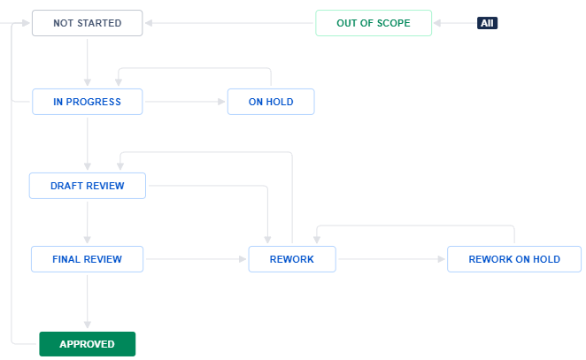
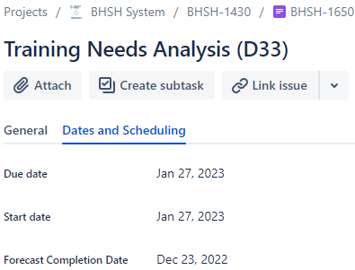

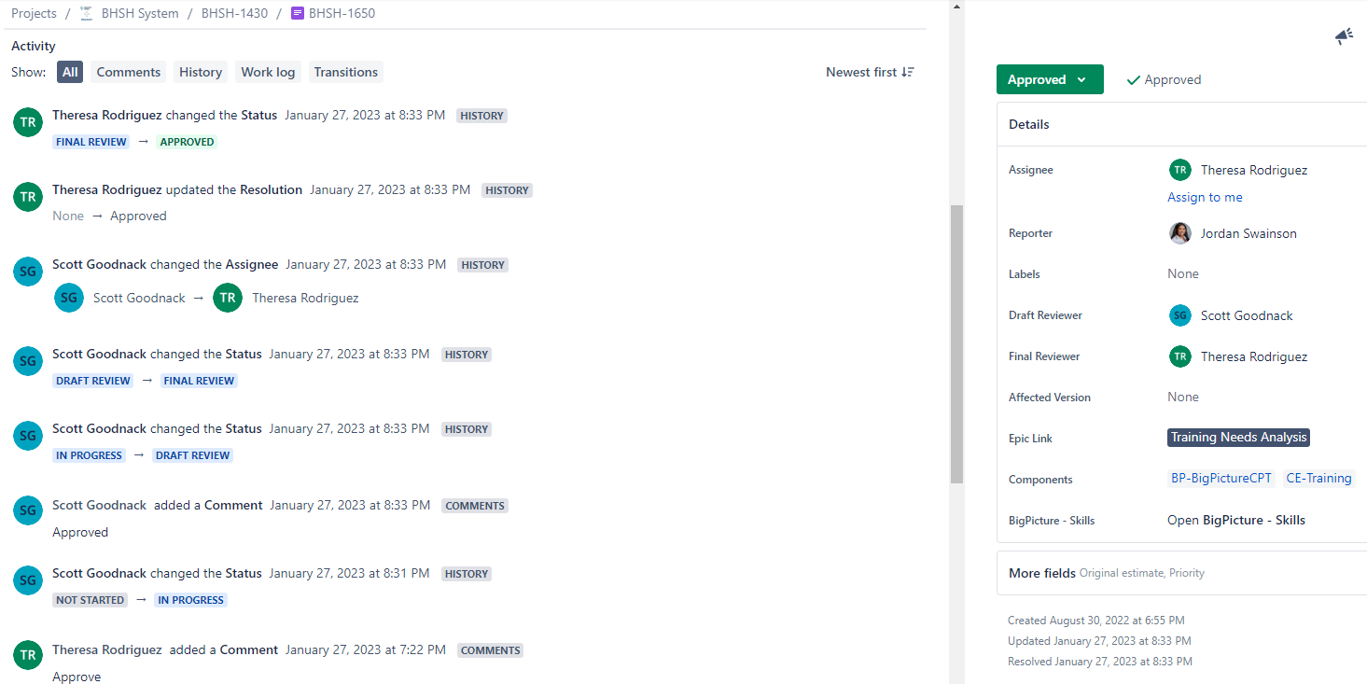
Development Tracking - Jira Demonstration
Learning content development and updates will be tracked in Jira. Deliverable tickets will ensure that assignments, due dates and feedback are documented and reportable.
1
2
3
3
4
JIRA Guide
Due Date: Submission date for deliverable
Start Date: Beginning working date for deliverable
Issue Status: Indicates deliverables current progress through the development process
Assignee/Draft Reviewer: Corewell SME assigned to ensure training material is complete and correct
Final Reviewer: Corewell Lead who acts as the final approval in the workflow
4
5
3
3
3

Slide 15
Training Development Approach – New Content
The training material development process is comprehensive and repeatable. This process includes quality review. Prior to the capturing process, functional areas will be responsible for ensuring that data is staged, security roles have been tested, and recommended paths to complete each business process have been defined and approved.
KPMG Training Team
STOP
Develop/revise training materials and post draft content to JIRA for review
Prepare for publishing to HealthStream / ServiceNow
START
SME proposes new learning content for Training
Capture recommended path to complete each curriculum task
Y
Content is ready for approval
Data is staged, security roles have been tested, happy path established
Y
Corewell Health SMEs
Content is scripted by SME for development
N
Provide feedback in JIRA
N
Provide sign off in JIRA
N
Note: Status tracking and approvals for content will occur in JIRA.
Notes:
SME has proposed new content for training
Content is scripted by SME for development.
Data is staged, security roles have been tested, happy path established
Content is recorded/documented
KPMG attaches materials to JIRA for Approval

Slide 16
Training Development Approach – Legacy Content
The training material development process is comprehensive and repeatable. This process includes quality review. Prior to the capturing process, functional areas will be responsible for ensuring that data is staged, security roles have been tested, and recommended paths to complete each business process have been defined and approved.
KPMG Training Team
STOP
Develop/revise training materials and post draft content to JIRA for review
Prepare for publishing to ServiceNow / HealthStream
START
Y
Legacy content is marked for update. JIRA created, details provided, attaching materials to JIRA
Is the update Minor?
Capture recommended path to complete each curriculum task
Corewell Health SMEs
N
Content is ready for approval
Provide sign off in JIRA
Y
Y
Sequence curriculum tasks for capture/development
Data has been staged, security roles have been tested, happy path established
Provide feedback in JIRA
N
N
Note: Status tracking and approvals for content will occur in JIRA.
Notes:
Steps needed for legacy content
CH – Document Legacy content that requires updating and the severity of the update (minor vs major)
JIRA generated with legacy content attached and details into what changes are required.
KPMG reviews JIRA and provides and further clarifying questions/comments
KPMG Develops and revises training updates, followed by attaching updated material to JIRA
CH – Reviews, Provides Feedback in JIRA, or Approves Content
KPMG Publishes updated material (Source, and applicable Links)

Slide 17
Terminology
Term | Definition
ESS/MSS Training | Employee Self Service (ESS) and Manager Self Service (MSS) refers to the training materials for all employees who will use Workday for self-service and manager/leader self-service purposes, e.g., are not using Workday for their day-to-day job
Back office Training | Refers to the training required to get HR, SCM and FIN employees prepared to do their job in Workday at Go-Live
JIRA | A software application developed by the Australian software company Atlassian that allows teams to track issues, manage projects, and automate workflows.
LMS | Learning Management System - a software application or web-based technology used to plan, implement and assess a specific learning process
TTT | Train-the-Trainer - a framework for training potential instructors or subject matter experts to enable them to train other people in their organizations
SME | Subject Matter Expert - a person who has special skills or knowledge on a particular job, topic, or business process
Current Approach:
Update Legacy Spectrum Workday Knowledge Articles and make them available as just-in-time resources for all Corewell Team Members
Develop Back Office Training for Corewell East functional teams by collaborating with and leveraging the knowledge/experience of Legacy Spectrum Health Team Members. Make all developed training materials available to Corewell West, South and Priority Health populations as optional refresher materials.

